Slide 1
Physical Change vs Chemical Change
LT #6 I can distinguish between physical and chemical processes.
Notes:
Chemical Reaction - Study Questions
1. What is a chemical reaction?
2. What is evidence a reaction has occurred?
3. What is a chemical equation?
4. Define reactants.
5. Define products.
6. Define catalyst.
7. What information is found in an equation?
8. What symbols are used to represent the states of matter?
9. What is the meaning of “aq”?
10. How do you indicate a catalyst is being used in a reaction?
11. What is activation energy?
12. What the three things does conservation of matter require of chemical equations?
13. What is the procedure for balancing a chemical equation?
14. Balance the equation for the reaction of magnesium chloride and silver nitrate to form magnesium nitrate and silver chloride.
15. What is a synthesis reaction?
16. How is a combustion reaction related to a synthesis reaction?
17. What type of reaction is an explosion?
18. Compare decomposition and dissociation.
19. What determines whether one metal will replace another in a single displacement reaction?
20. What is the general form of a double displacement reaction?
21. What type of reaction is each of these?
2Na(s) + Cl₂(g) → 2NaCl(s)
PCl₅(s) → PCl₃(s) + Cl₂(g)
2Al(s) + Fe₂O₃(s) → 2Fe(s) + Al₂O₃(s)
C₆H₁₂O₆(s) + 6O₂(g) → 6CO₂(g) + 6H₂O(l)
BaCl₂(aq) + H₂SO₄(aq) → 2HCl(aq) + BaSO₄(s)
22. What is the oxidation number of an element?
23. What is the oxidation number of the fluorine ion?
24. What is the sum of the oxidation numbers in a compound?
31. Can a redox reaction form a molecule? Explain your answer.

Slide 2
Physical vs Chemical Change
Do not write on the reading
On loose-leaf or in a notebook, take notes like you are going to teach the material include examples and visuals
When finished add your note sheet to your binder

Slide 3
Reciprocal Teaching
Partners stand with notebook/packet if needed.
Student A teaches Student B as though that student was absent for 2 minutes about PHYSICAL CHANGE.
Students switch roles. Student B will go through their notes as through Student A was absent for 2 minutes about PHYSICAL CHANGE.

Slide 4
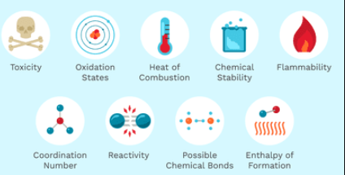
Side Note
Physical Properties
Describes a substance
Chemical Properties
Describes how it can form a new substance
PAGE 3 in packet

Slide 5
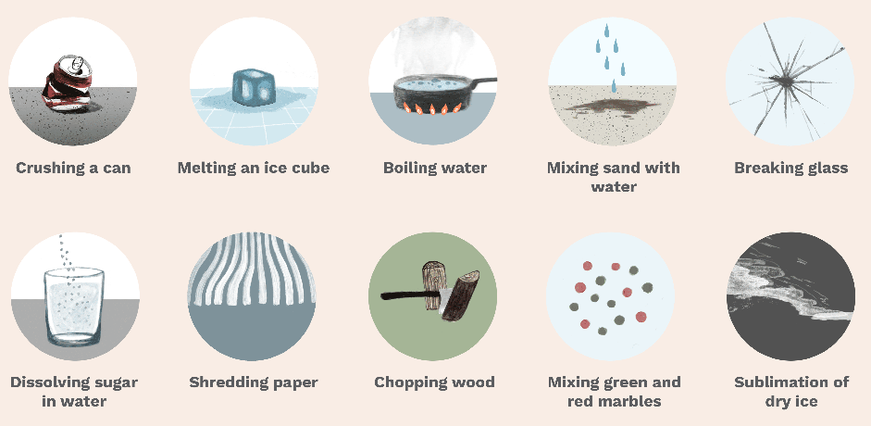
Physical Change
No new substance is formed
Properties of a material change
BUT the composition of the material does NOT change

Slide 6
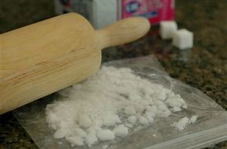
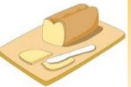
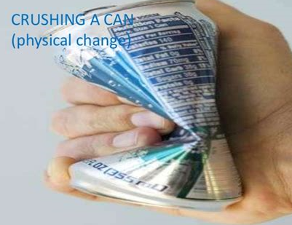
Physical Change
Physical Manipulation
Size: grind, cut, dissolve, stretch
Magnetize

Slide 7
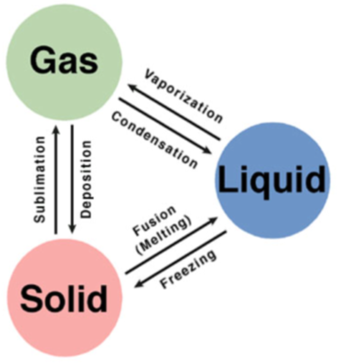
Physical Change
Fill the chart with the phase change that matches up
You can use your notes that you took yesterday
Phase Change
Evaporation

Slide 8
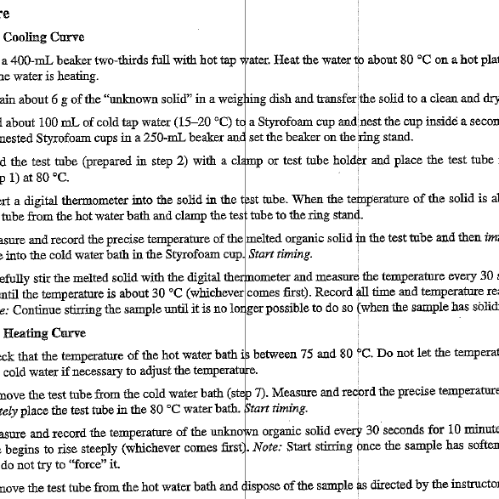
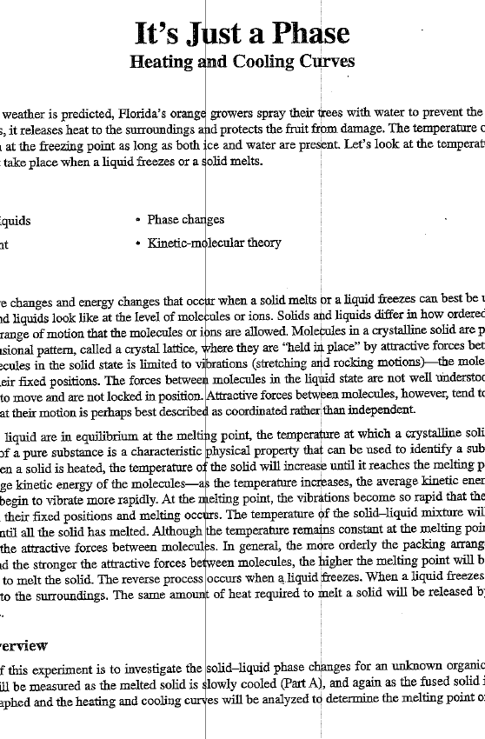
It’s Just a Phase Lab
PAGE 14: Annotate the Intro, Concepts, Background, and Experiment Overview
PAGE 15 – in your lab groups: For each step in the procedure, draw a visual to represent what the lab is asking you to do in that step.

Slide 9
It’s Just a Phase Lab
PAGE 17 & 18
#1 - graph your data
#2 – call me over to describe
#3 – 7: work on them

Slide 10
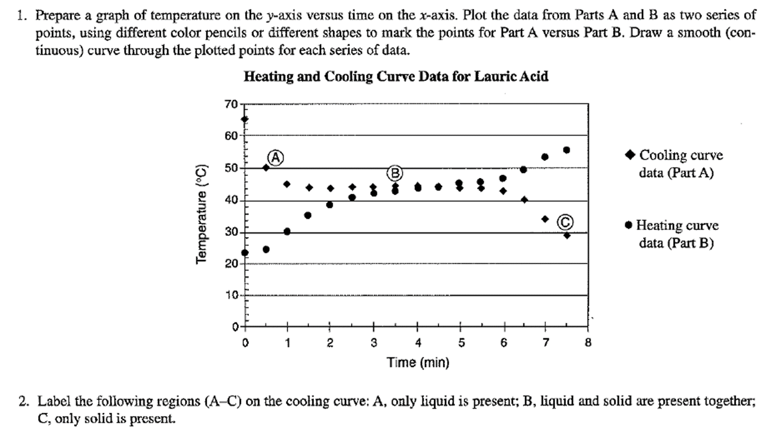

Slide 11
Particle
Movement
Increases with time and energy →

Slide 12
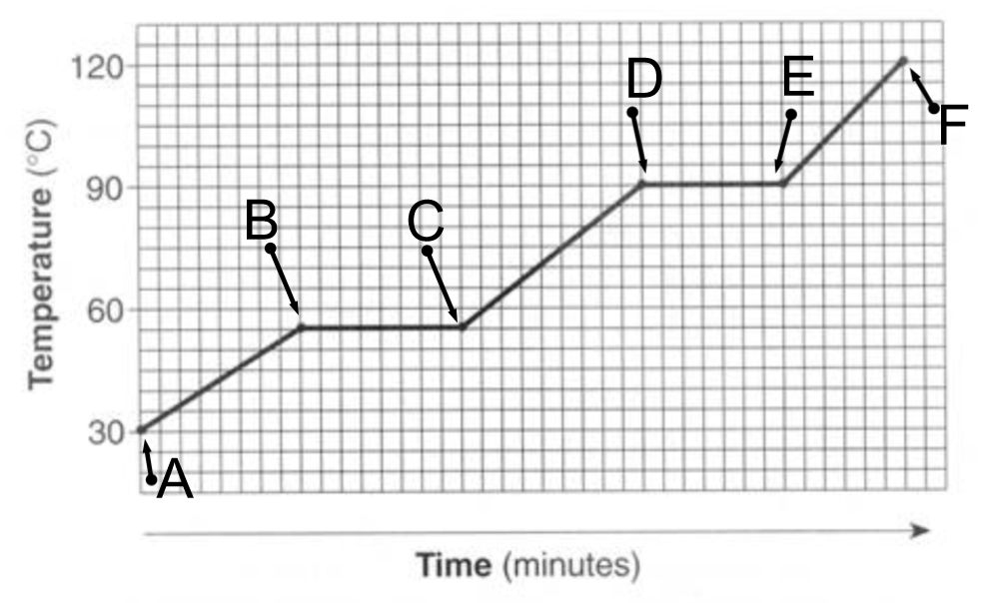
How to Read Phase Change Diagrams

Slide 13
Individual – 4 minutes Partners – 2 minutes
Page 8
Skip #9 and 10
Page 9
No need to sketch the graph on your paper. Just label the graph that on your paper.

Slide 14
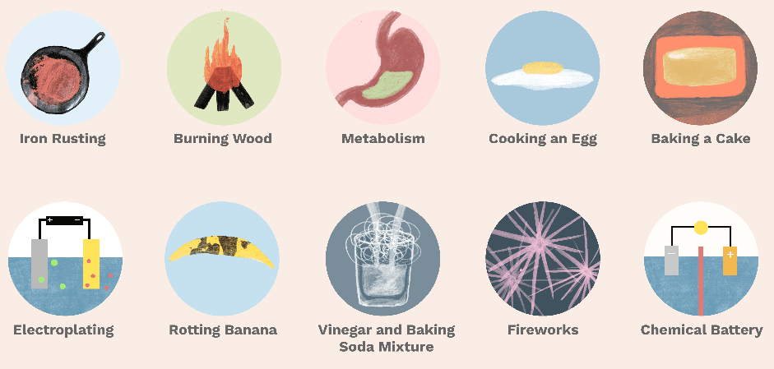
Chemical Change
New substance formed
Change that produces matter with a different composition than the original matter
Chemical bonds are broken and new chemical bonds are formed

Slide 15
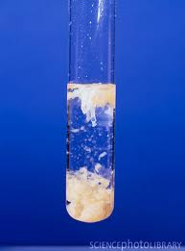
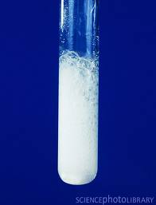
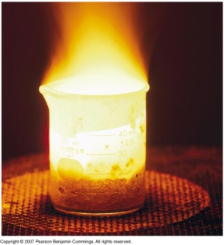
Signs of Chemical Change
There are 5 main signs that indicate a chemical reaction has taken place:
release
input
production of
new gases or vapor
(bubbles)
change in
color
change in
odor
input or
release
of energy
(sound,
light, heat)
Formation of a
precipitate

Slide 16
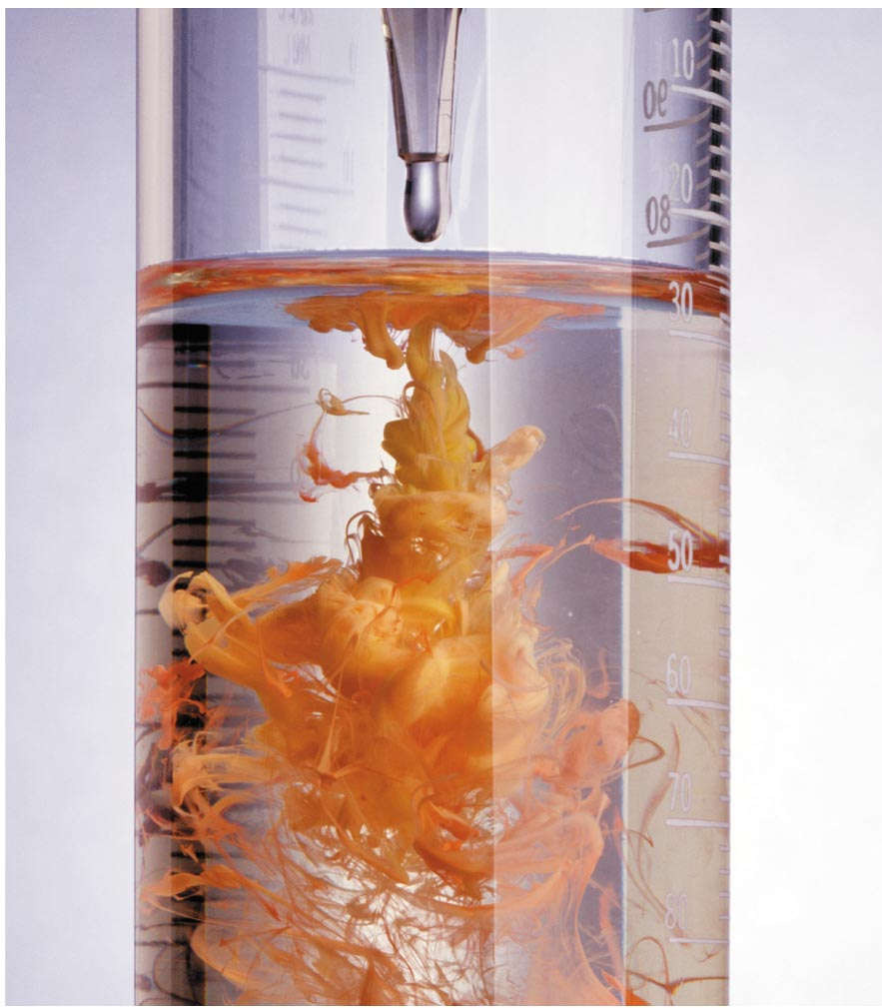
Precipitate
the formation of a solid in a soln or inside
another solid during a chem rxn
Notes:
A reaction that yields an insoluble product, a precipitate, when two solutions are mixed
Are a subclass of exchange reactions that occur between ionic compounds when one of the products is insoluble
Used to isolate metals that have been extracted from their ores and to recover precious metals for recycling

Slide 17
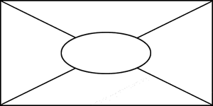
Placemat
Physical vs Chemical Change
One person, draw the diagram above on the whiteboard.
No writing, just think for 1 min.
Each student will have a different color. Write your ideas in the closest section to you for 2 minutes, no talking. LEAVE THE MIDDLE SECTION BLANK
Go around the table and share your ideas.
The group should summarize the group’s consensus of ideas and write in the middle section of the placemat.
Be prepared to share out to the class – choose one person to present.

Slide 18
Smartboard File Physical vs Chem T Chart

